Slide 1

ATLIQ HARDWARE Sales Insights FROM ad-hoc requests
By Karthikraj Sooraj J
August 20th 2023

Slide 2
AGENDA
Introduction
Insights
Queries
Conclusion
Appendix

Slide 3
Introduction
Introduction to Atliq Hardware: Atliq Hardware has established itself as a prominent player in the computer hardware industry in India.
With a global customer base, the company has consistently delivered high-quality products that cater to the diverse needs of both individual and corporate clients.
In an era where data-driven decision-making is a critical aspect of business success, Atliq Hardware recognizes the value of leveraging sales data to gain deep insights into product performance and customer preferences.
This strategic move allows the company to adapt and align its offerings with market demands effectively.

Slide 4
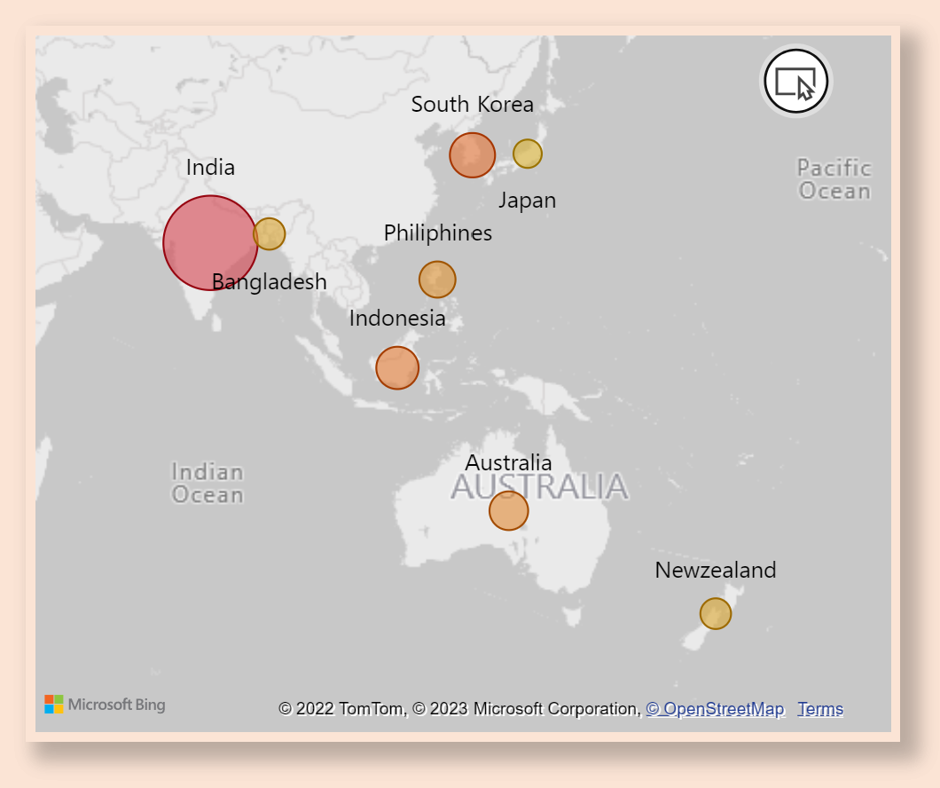
INSIGHTS
Q1. LIST OF MARKETS WHERE CUSTOMER “ATLIQ EXCLUSIVE” OPERATES BUSINESS IN “ASIA PACIFIC” REGION for Fiscal year 2020-2021
India is a leading market in terms of Gross Sales for Atliq Exclusive in Asia Pacific region out of 8 countries, followed by South Korea, Indonesia,Japan,Bangladesh,Philiphines, Australia and Newzealand.

Slide 5
INSIGHTS Q2. Change in NUMBER OF unique products Q3. Unique products in each segment
44%
Common unique products
We observe a 44% rise in number of unique products from 2020 to 2021.
Atliq hardware can research on current trends as well as needs and introduce some new products in Networking and Storage segments.

Slide 6
INSIGHTS Q4. % CHANGE OF UNIQUE PRODUCTS IN EACH SEGMENT FROM PREVIOUS YEAR
For Atliq hardware, Desktop segment saw highest comparative increase in its products in year 2021.

Slide 7
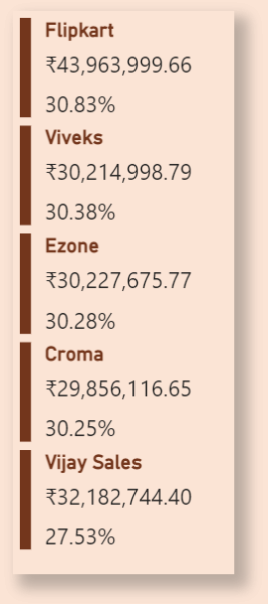


INSIGHTS Q5. Top 5 customers with highest average pct discount for fiscal year 2021 in Indian market
FlipKart with highest average discount brings in the highest sales. This strategy of discount with customers is working well for the company.
Q6. Product with Max Manufacturing cost
- AQ Home Allin1 Gen2
Q6. Product with Min Manufacturing cost
- AQ Master Wired X1 MS

Slide 8
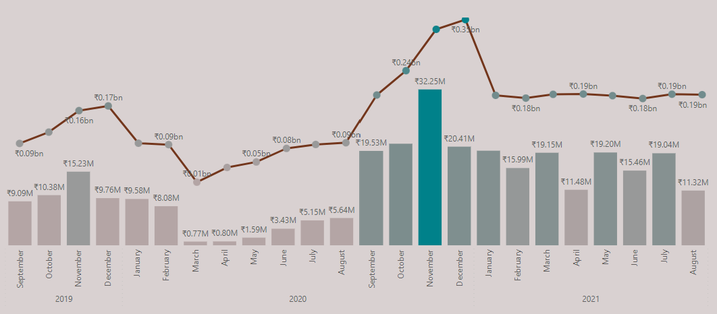
INSIGHTS Q7. Gross sales for CUSTOMER “atliq exclusive” for each month
GROSS SALES ALL CUSTOMERS
GROSS SALES ATLIQ EXCLUSIVE
Atliq hardware can introduce some products to increase sales in summer. Overall the sales have increased after pandemic and have remained consistently high then pre pandemic year.

Slide 9
INSIGHTS Q8. Quarter with max quantities sold for fiscal year 2020
Quarters FOR FISCAL YEAR 2020
Q1
SEP’19
OCT’19
NOV’19
7M
For fiscal year 2020, Q3 was with the least products sold. In summer the computer hardware demand decreases and Atliq Hardware can come up with some outdoor products like waterproof speakers to hike up the sales.
Q2
DEC’19
JAN’20
FEB’20
6.6M
Q3
MAR’20
APR’20
MAY’20
2M
Q4
JUN’20
JUL’20
AUG’20
5M

Slide 10
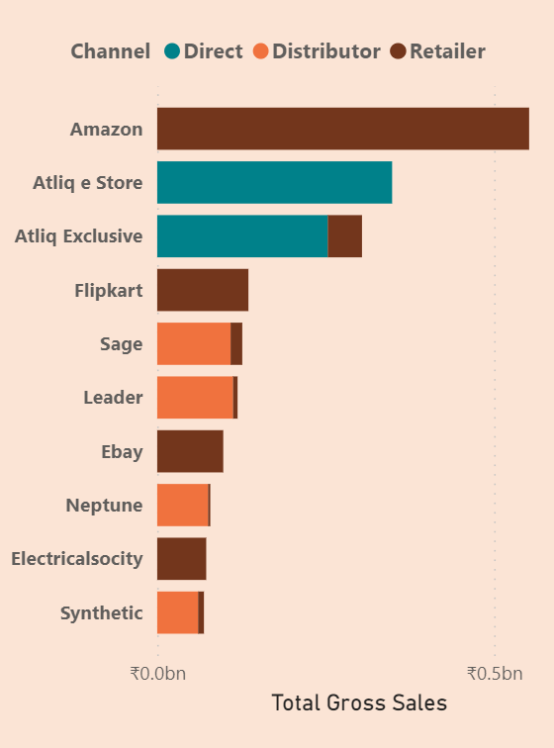



INSIGHTS Q9. Channels with gross sales and its Percentage contribution
retailer
direct
distributor
₹ 1.92 bn (73.22 %)
₹ 0.40 bn (15.47 %)
₹ 0.29 bn (11.31 %)

Slide 11
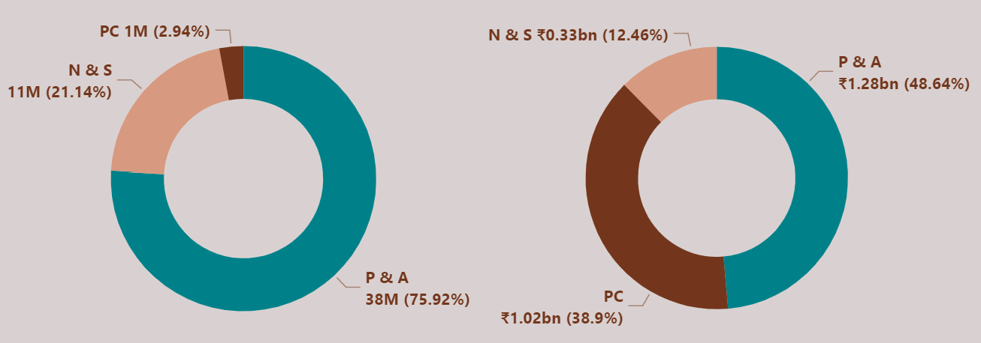
INSIGHTS Q10. Top 3 products in each division with highest quantity sold in fiscal year 2021
division | product_code | product | total_sold_quantity | rank_order
N & S | A6720160103 | AQ Pen Drive 2 IN 1(Premium) | 701373 | 1
N & S | A6818160202 | AQ Pen Drive DRC(Plus) | 688003 | 2
N & S | A6819160203 | AQ Pen Drive DRC(Premium) | 676245 | 3
P & A | A2319150302 | AQ Gamers Ms(Standard 2) | 428498 | 1
P & A | A2520150501 | AQ Maxima Ms(Standard 1) | 419865 | 2
P & A | A2520150504 | AQ Maxima Ms(Plus 2) | 419471 | 3
PC | A4218110202 | AQ Digit(Standard Blue) | 17434 | 1
PC | A4319110306 | AQ Velocity(Plus Red) | 17280 | 2
PC | A4218110208 | AQ Digit(Premium Misty Green) | 17275 | 3
Even though P & A accounts for the division with maximum quantities sold, the products with highest quantities sold belongs to N & S. Quantities sold in PC division are significantly lower than other two divisions but still accounts for 38.9% of all gross sales.

Slide 12
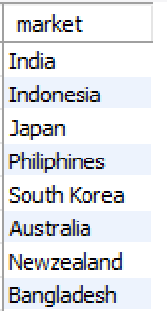
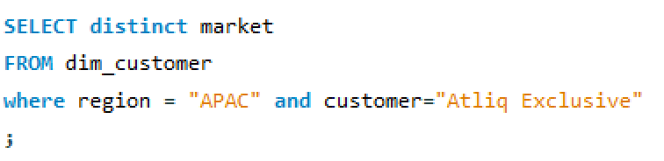
QUERIES
1. Provide the list of markets in which customer "Atliq Exclusive" operates its business in the APAC region.

Slide 13
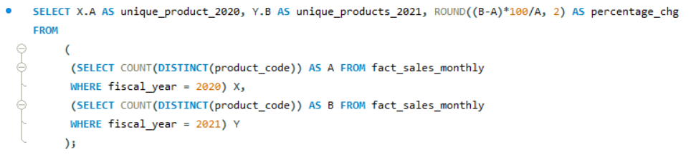

QUERIES
2. What is the percentage of unique product increase in 2021 vs. 2020?

Slide 14
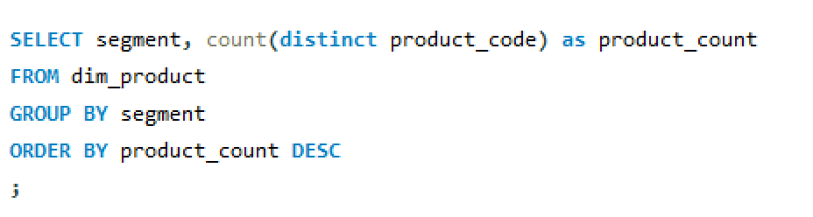
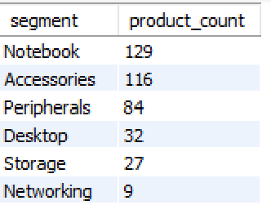
QUERIES
3. Provide a report with all the unique product counts for each segment and sort them in descending order of product counts

Slide 15
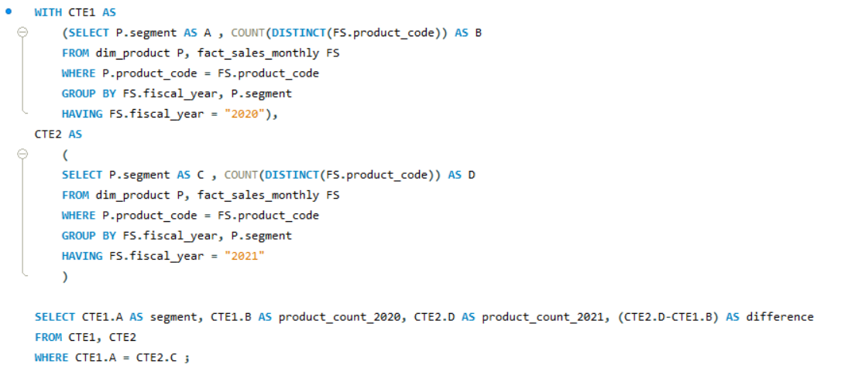
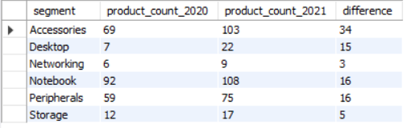
QUERIES
4. Follow-up: Which segment had the most increase in unique products in 2021 vs 2020?

Slide 16
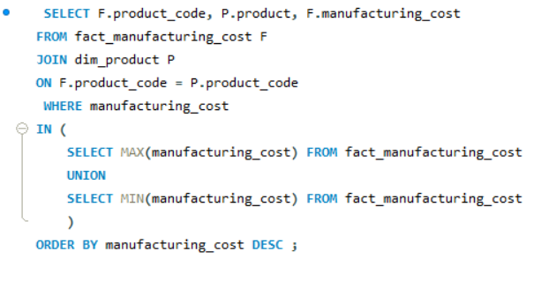

QUERIES
5. Get the products that have the highest and lowest manufacturing costs.

Slide 17
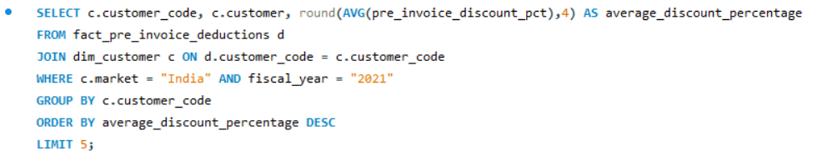
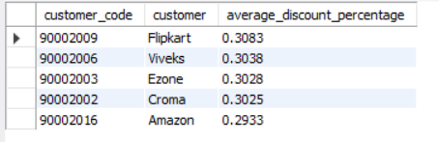
QUERIES
6. Generate a report which contains the top 5 customers who received an average high pre_invoice_discount_pct for the fiscal year 2021 and in the Indian market.

Slide 18
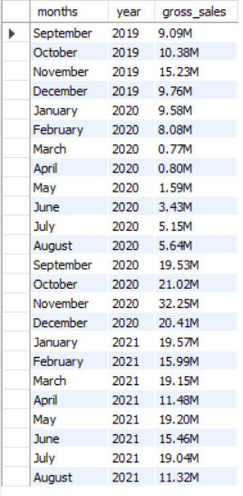
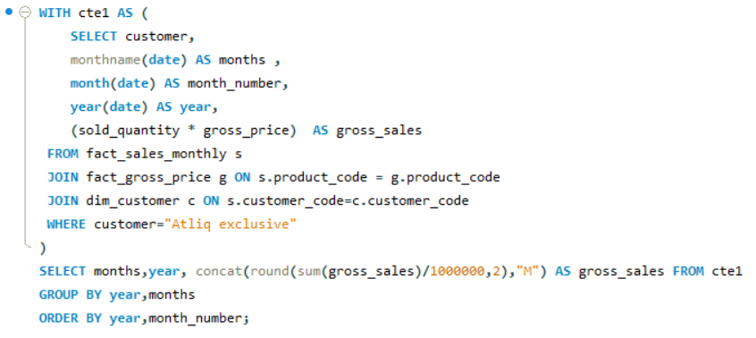
QUERIES
7. Get the complete report of the Gross sales amount for the customer “Atliq Exclusive” for each month.

Slide 19
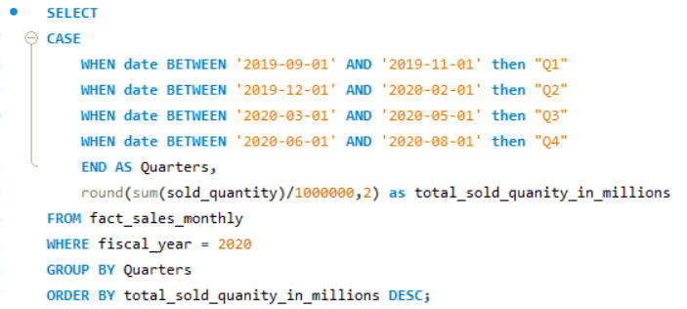
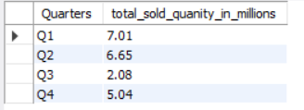
QUERIES
8. In which quarter of 2020, got the maximum total_sold_quantity?

Slide 20
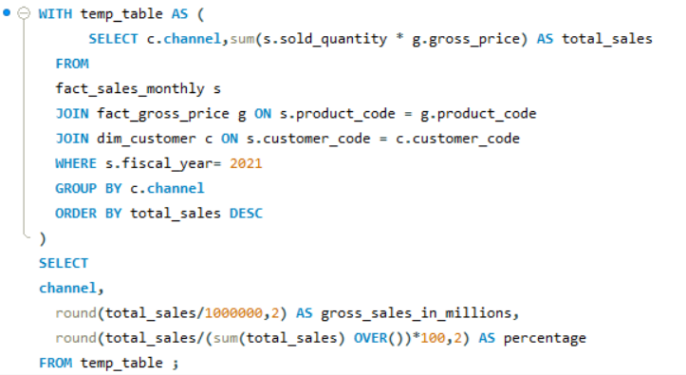

QUERIES
9. Which channel helped to bring more gross sales in the fiscal year 2021 and the percentage of contribution?

Slide 21
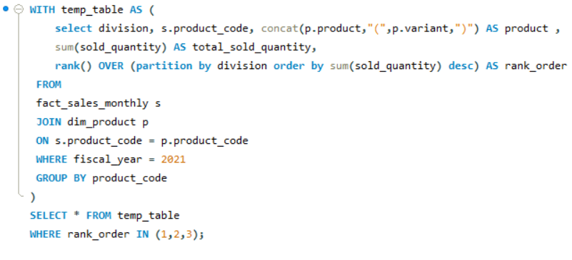
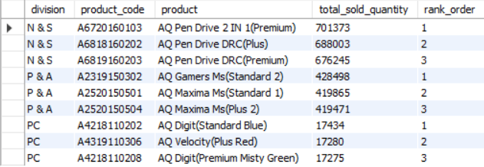
QUERIES
10. Get the Top 3 products in each division that have a high total_sold_quantity in the fiscal_year 2021?

Slide 22
CONCLUSION
Atliq Hardware has performed well in year 2021 introducing 102 new products with Peripherals and Accessories bringing in the highest revenue followed by PC.
PC is the strongest performing division, generating 39% of total sales while accounting for only 3% of overall quantities of products sold.
Try to tweak discounts rates such that the customers bring in more gross sales for the company.
Space to increase e-commerce sales by partnering with new e-commerce platforms with competitive discounts.

Slide 23
APPENDIX
Project on GitHub:
https://github.com/KarthikSooraj/Consumer-Goods-Ad-hoc-Insights.git
Codebasics challenge #4:
https://codebasics.io/event/codebasics-resume-project-challenge

Slide 24


